Slide 1
SQL Injection(SQLi)
501026 Byeongchan Gwak
Notes:
Clearly describe the details/findings/contributions of your topic
Explain why/what you find interesting or important about it
Pose 2 or more questions about it for follow up discussion

Slide 2
I’m going to cover…
What SQL injection is?
How to do it?
What can we do?
How to prevent it?
Why is it interesting?
2 open questions

Slide 3
What if …
There’s a hacking tool which is
Looking cool but hard to use
Looking not that cool, but powerful and easy to use

Slide 4
What is it?
SQL Injection!
Allows an attacker to view data that it is not normally able to retrieve
If you can answer those 3 questions, you are ready to go
Do you know what database is?
Do you know what SQL is?
Do you know several HTML form tags and GET & POST method?
Notes:
Concept is simple. Intercept SQL!
This might include data belonging to other users, or any other data that the application itself is able to access.
In many cases, an attacker can modify or delete this data, causing persistent changes to the application's content or behavior.
A successful SQL injection attack can result in unauthorized access to sensitive data, such as passwords, credit card details, or personal user information
Inject attacker’s query into a target system through vulnerable parameter

Slide 5
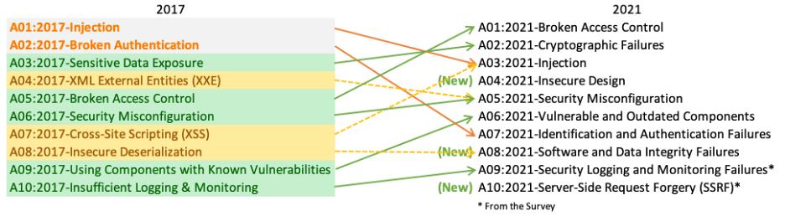
OWASP Top 10 - 2021
The Open Web Application Security Project® (OWASP)
A nonprofit foundation that works to improve the security of software
The OWASP Top 10 is a standard awareness document for developers and web application security.

Slide 6
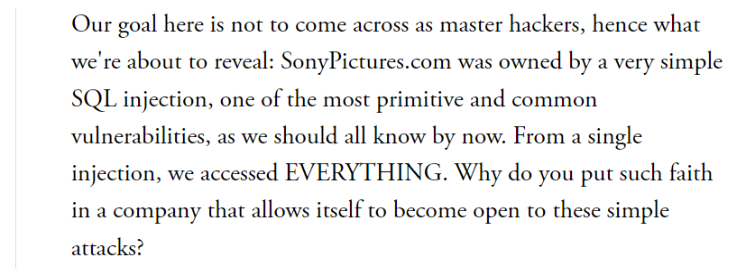
Case study – Pool Sony…
One million user information was hacked in 2011
SQL Injection method used
LulzSec(A group of black hat hackers) said,

Slide 7
How to do it?
Damn Vulnerable Web App (DVWA)
A Web application that is vulnerable
Helps web developers better understand the processes of securing web applications
Let's see how to do it using DVWA

Slide 8
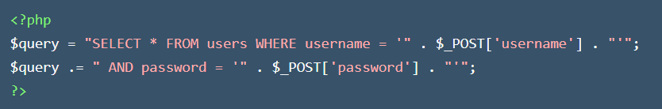
Imagine that …
SELECT * FROM users WHERE username=‘bcgwak' AND password='12345’
SELECT * FROM users WHERE username=‘bcgwak’ -- AND password='12345’

Slide 9
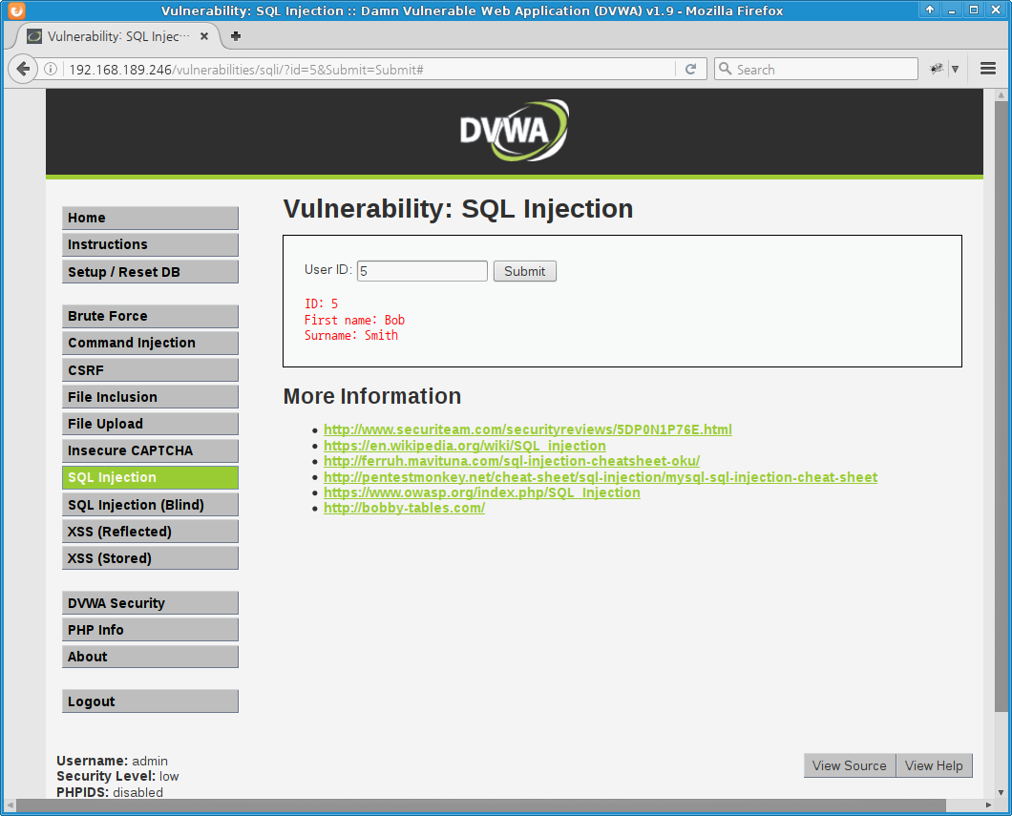
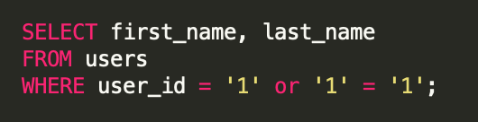
Attack #1

Slide 10
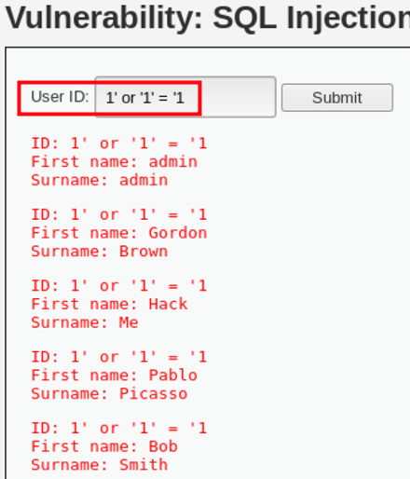
Attack #1

Slide 11
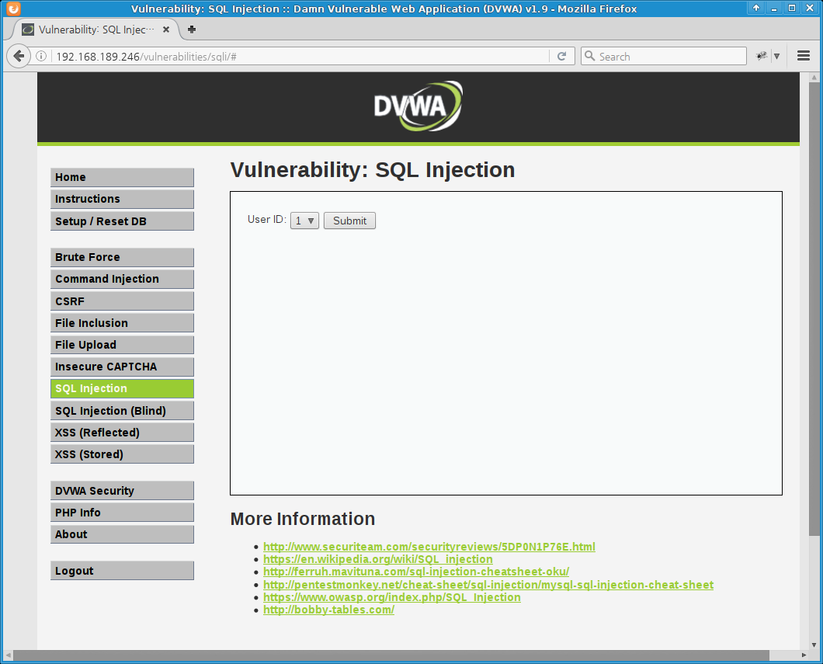
Attack #2

Slide 12
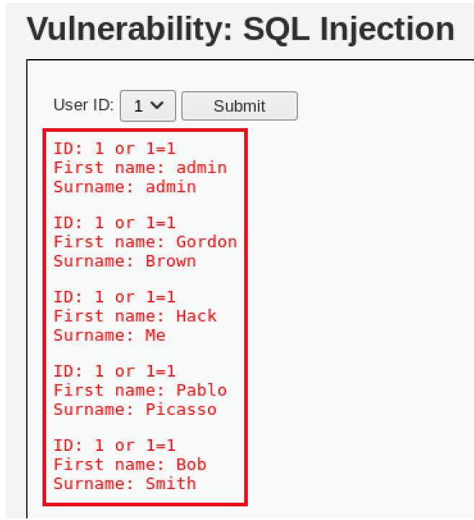
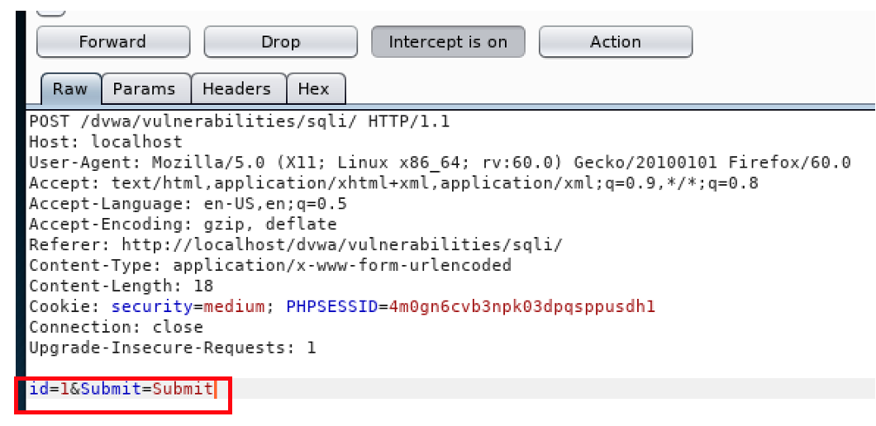
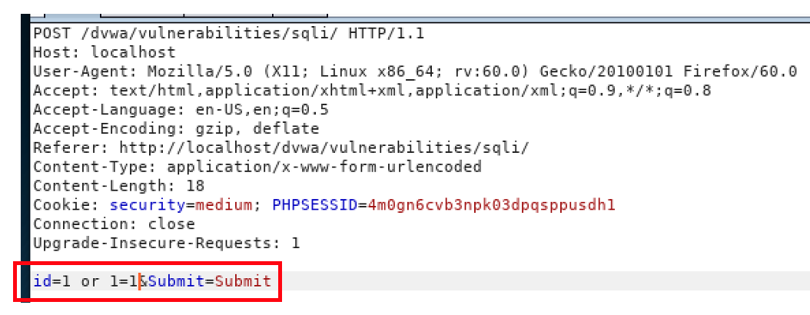
Attack #2

Slide 13
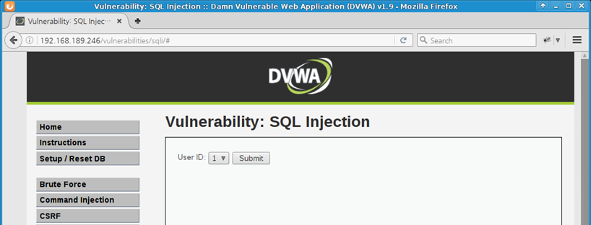
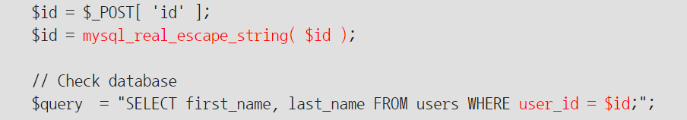
Attack #2-1

Slide 14
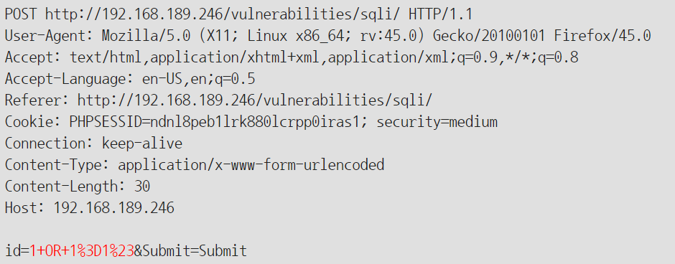
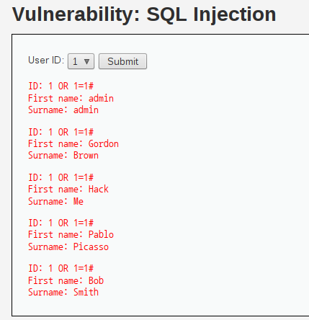
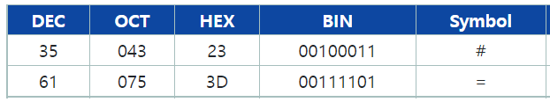
Attack #2-1

Slide 15
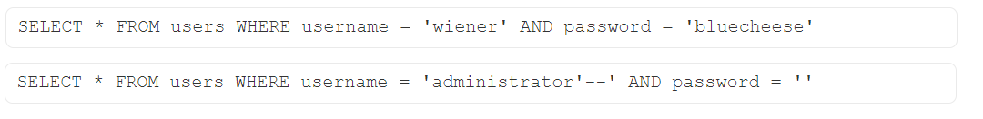
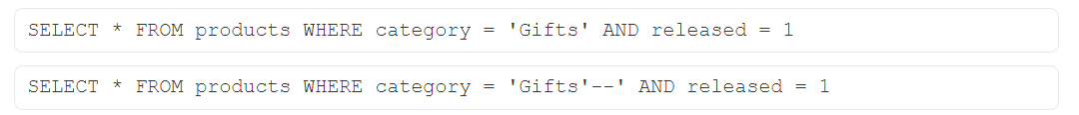
What can we do?
Subverting application logic
Retrieving hidden data
Retrieve interesting data with UNION attack

Slide 16
How to prevent it #1
Parameterized query
Before
String query = "SELECT * FROM products WHERE category = '"+ input + “’”;
After
PreparedStatement statement = connection.prepareStatement("SELECT * FROM products WHERE category = ?"); statement.setString(1, input);
Notes:
Input validation: If the website allows user input, this input should be verified whether it’s allowed or not.
Parametrized queries: This is a technique where the SQL statements are precompiled and all you have to do is supply the parameters for the SQL statement to be executed.
Use Stored procedures
Use character-escaping functions
Avoid administrative privileges - Don't connect your application to the database using an account with root access
Implement a Web application firewall (WAF)

Slide 17
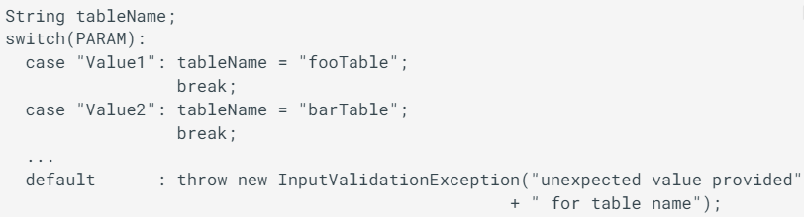
How to prevent it #2
Make sure unvalidated user input doesn't end up in the query
Notes:
Input validation: If the website allows user input, this input should be verified whether it’s allowed or not.
Parametrized queries: This is a technique where the SQL statements are precompiled and all you have to do is supply the parameters for the SQL statement to be executed.
Use Stored procedures
Use character-escaping functions
Avoid administrative privileges - Don't connect your application to the database using an account with root access
Implement a Web application firewall (WAF)

Slide 18
Why is it interesting?
Cost effectiveness
Easy to understand
Easy to exploit(A bit hard to find)
Impact could be huge
Notes:
가장 큰 특징은 저비용으로 고효율의 결과물을 얻어낼 수 있다는 것이다.

Slide 19
Lastly, poses 2 open questions
Is it also possible in NO-SQL system?
Is it possible to prevent SQL Injection thoroughly?

Slide 20
References
https://cheatsheetseries.owasp.org/cheatsheets/SQL_Injection_Prevention_Cheat_Sheet.html
https://portswigger.net/web-security/sql-injection
https://www.theatlantic.com/technology/archive/2011/09/lulzsecs-sony-hack-really-was-simple-it-claimed/335527/
https://paalsh.com/index.php/2021/03/11/using-sql-injection-how-lulzsec-hacked-sony-music-in-2011/

